Slide 1

Regular expressions
1
A crash intro to regular expression

Slide 2

How to construct regular expressions
2
A crash intro to regular expression

Slide 3
How to construct regular expressions
A regular expression is a sequence of characters that defines a search pattern, for pattern matching.
We have used wildcard/joker characters like *, !, +... this is much simpler and older than regular expressions.
3
A crash intro to regular expression

Slide 4

How to construct regular expressions
Regular expressions can be represent by automata. You move from one state to another when the character you read matches the transition.
d
o
g
0
1
2
3
d o t
If there is no transition for what you read, or you are done reading and have not reached a final state, the word is not accepted. Otherwise, it is.
4
A crash intro to regular expression

Slide 5
How to construct regular expressions
What word(s) would this automaton accept?
d
o
g
0
1
2
3
s
d o g
d o g s
5
A crash intro to regular expression

Slide 6


How to construct regular expressions
A transition that accepts any symbol is shown by ε
d
o
ε
0
1
2
3
d o t
d o g
d o m
d o
d i m
6
A crash intro to regular expression

Slide 7
How to construct regular expressions
A transition that accepts any symbol is shown by ε
.
t
x
t
0
1
2
3
4
Accepts any file whose extension is .txt
ε
Any amount of anything
Wildcard syntax: *.txt
Regular expression syntax: .*\.txt
Any one thing
Any amount of the previous
7
A crash intro to regular expression

Slide 8

How to construct regular expressions
A common mistake is to use wildcard symbols ‘just the same’ for regular expressions. But they don’t do the same thing! Think of them as totally different!
8
A crash intro to regular expression

Slide 9
How to construct regular expressions
Accepts any file like woootwooot
Any number of o
w
t
w
t
0
1
2
3
4
o
o
Wildcard syntax: none?
Regular expression syntax: wo*two*t
9
A crash intro to regular expression

Slide 10
How to construct regular expressions
Accepts any file like woootwooot
o
Any number of o
w
ε
t
w
0
1
2
3
4
ε
o
Would this do the job?
5
No. It would accept witwit too...
t
6
10
A crash intro to regular expression

Slide 11
How to construct regular expressions
Accepts any file like woootwooot
o
At least one o
w
ε
t
w
0
1
o
4
2
3
ε
o
o
Wildcard syntax: none?
Regular expression syntax: woo*twoo*t
5
t
6
11
A crash intro to regular expression

Slide 12
How to construct regular expressions
Accepts any file like woootwooot
At least one o
w
o
t
w
0
1
2
3
4
o
o
o
Wildcard syntax: none?
Regular expression syntax: woo*twoo*t
5
t
This automaton would be better because it’s not ambiguous.
6
12
A crash intro to regular expression

Slide 13
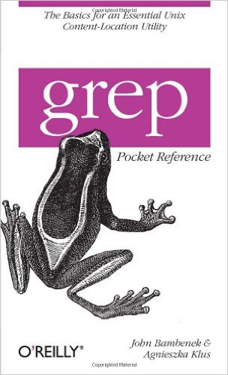
Finding lines by regex: Grep
13
A crash intro to regular expression

Slide 14
Finding lines by regex: Grep
grep is the global regular expression parser. It searches files for lines that contain the string described by the regular expression.
14
A crash intro to regular expression

Slide 15
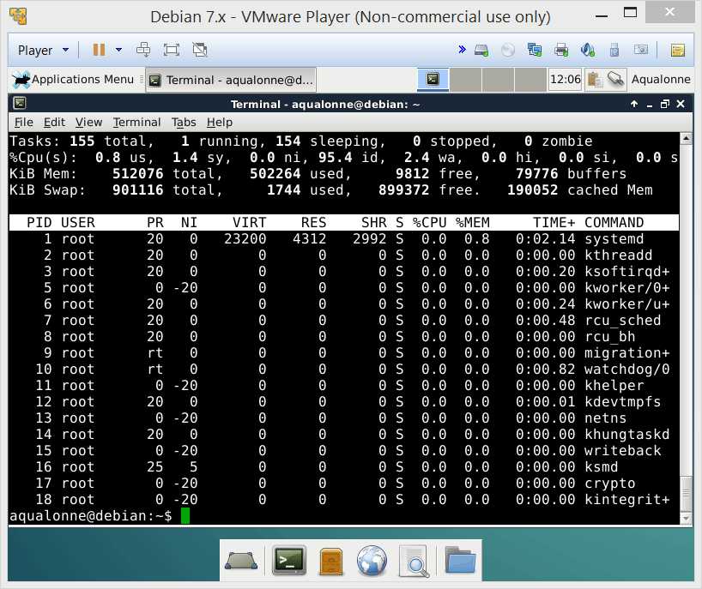
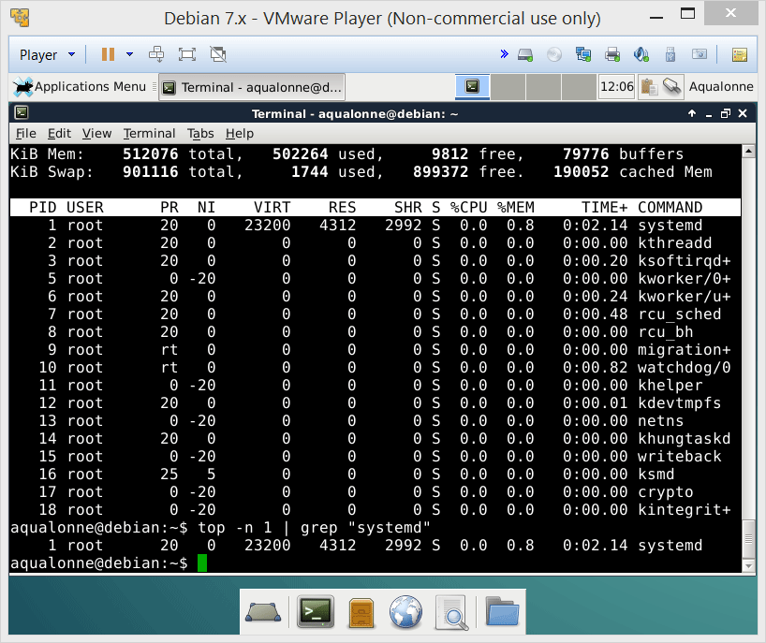
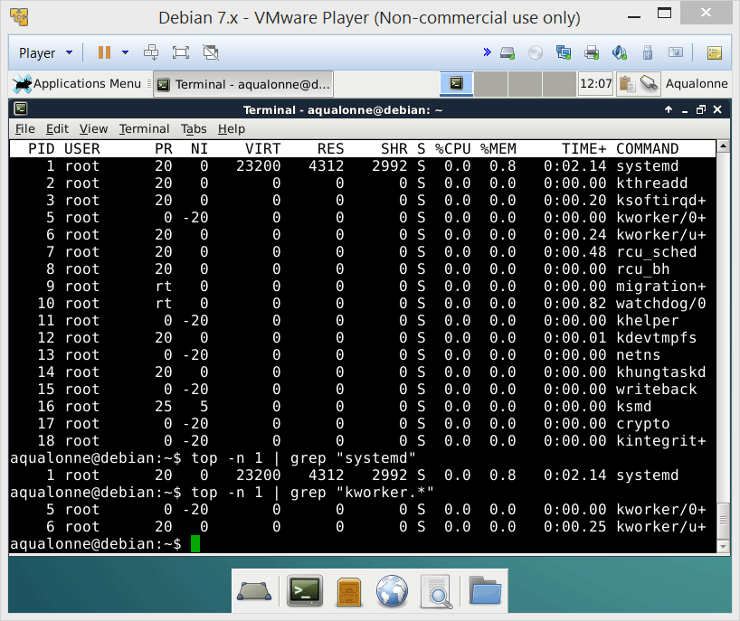
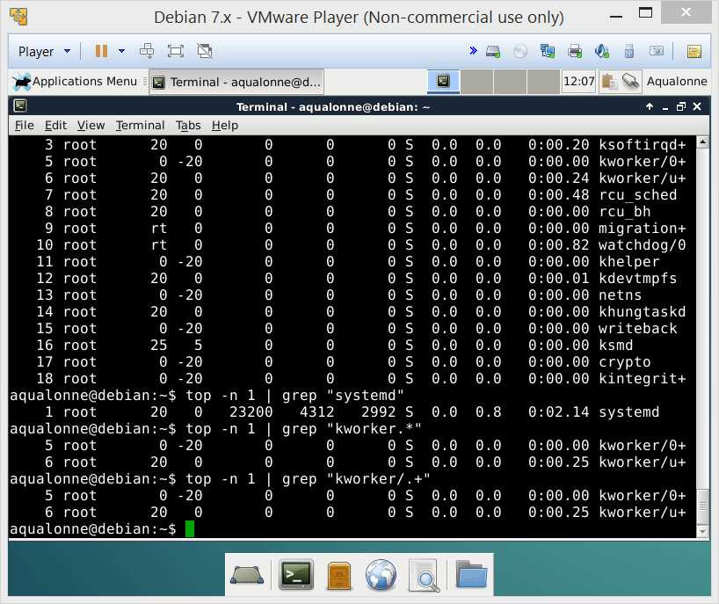
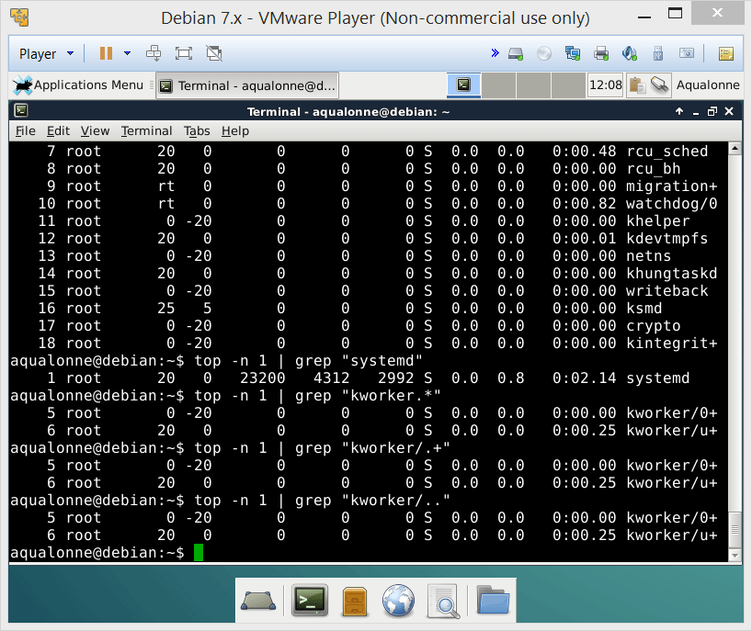
Finding lines by regex: Grep
You can use:
an exact string
. for any one character
* for 0 or more of the previous character
15
A crash intro to regular expression

Slide 16
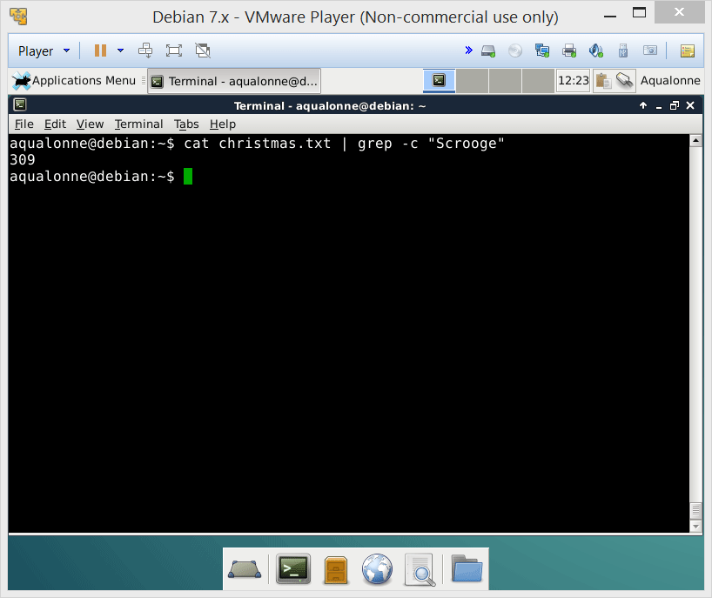
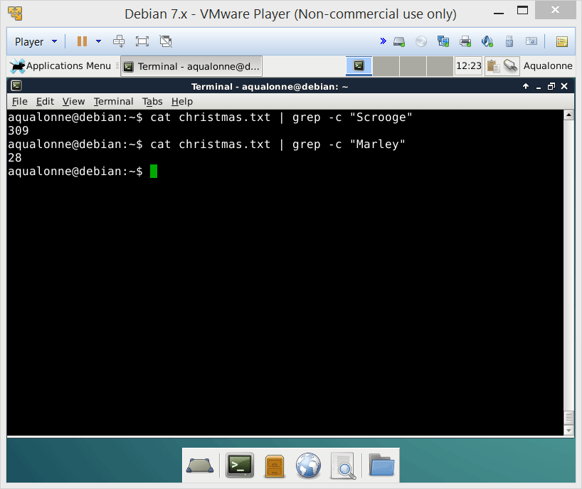
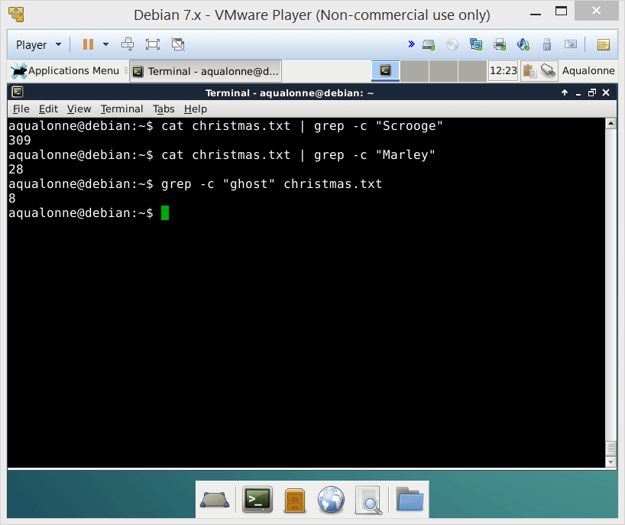
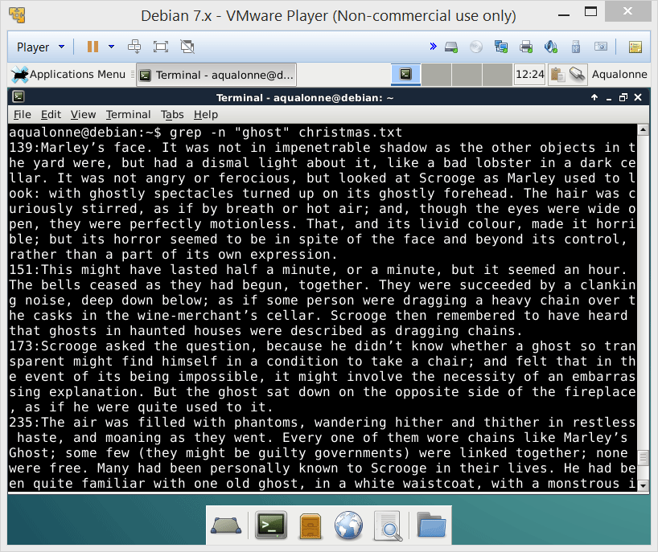


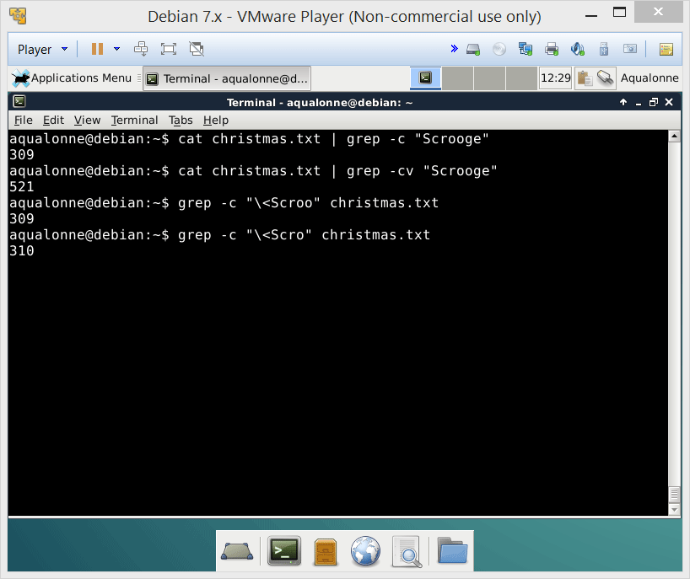
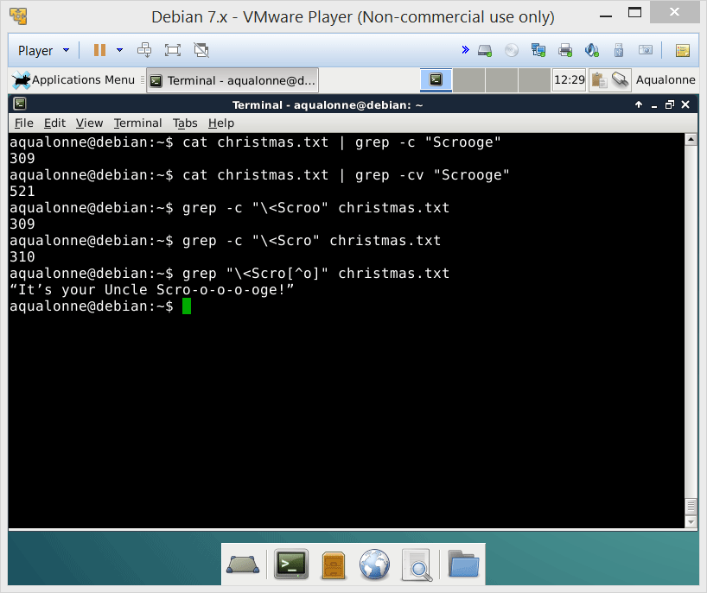
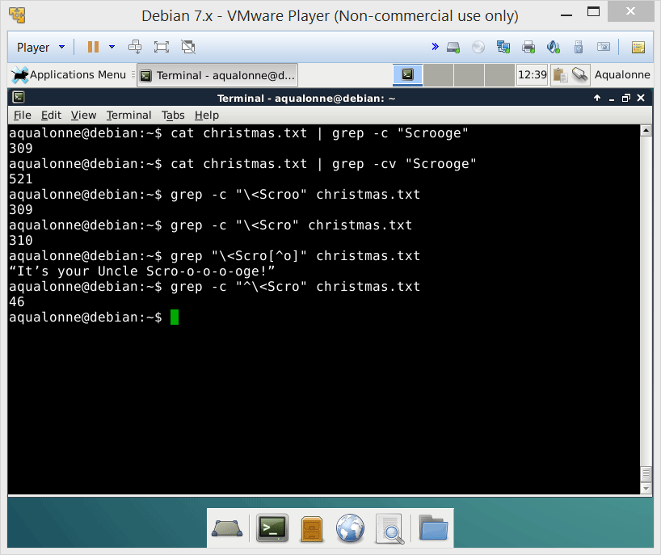

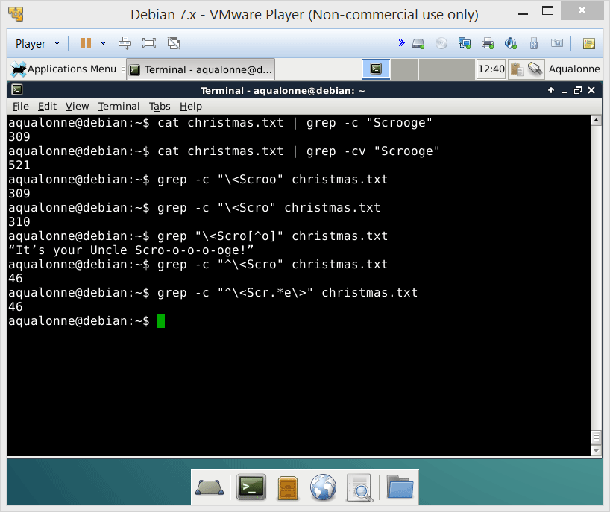
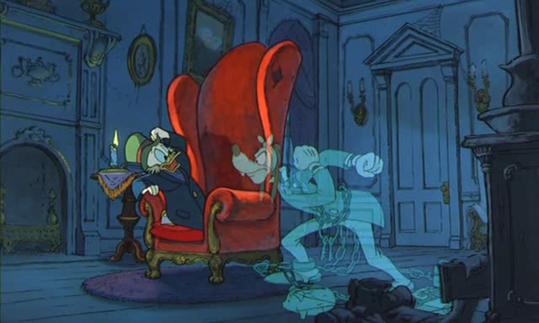
Finding lines by regex: Grep
You can use:
an exact string
. for any one character
* for 0 or more of the previous character
[^ ] to negate a character
\< to start a word
\> to end a word
^ begin line
$ end line
Grep options:
c count
v negate
n numbers lines
Word anchors
Line anchors
16
A crash intro to regular expression

Slide 17
Finding lines by regex: Grep
You can use:
an exact string
. for any one character
* for 0 or more of the previous character
[^ ] to negate a character
\< to start a word
\> to end a word
^ begin line
$ end line
Grep options:
c count
v negate
n numbers lines
How would you count sentences that...
Start with He?
grep -c “^He” christmas.txt
Do not include Christmas?
grep -cv “Christmas” christmas.txt
Include good .......and later in the text the word... old?
grep -c “good.*old” christmas.txt
Include good, but not old later on?
grep -c “good.*[^o][^l][^d]” christmas.txt
17
A crash intro to regular expression

Slide 18
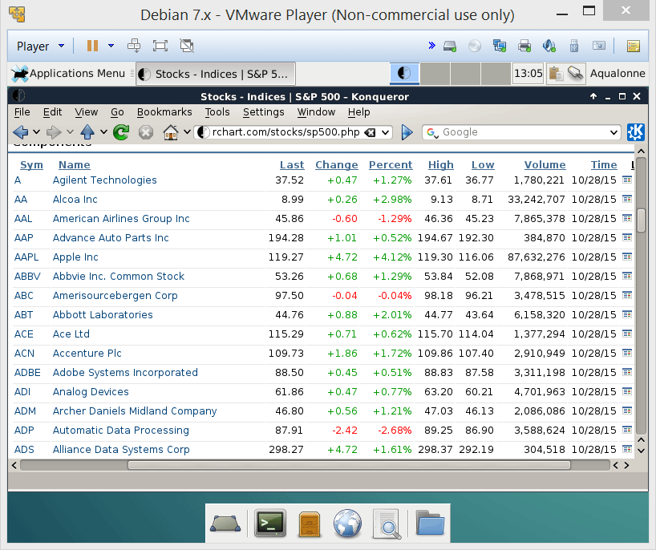
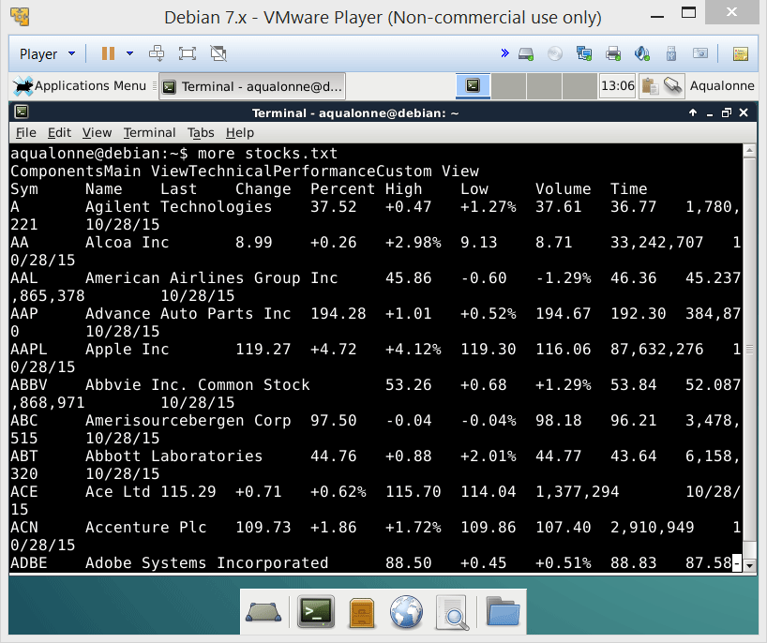


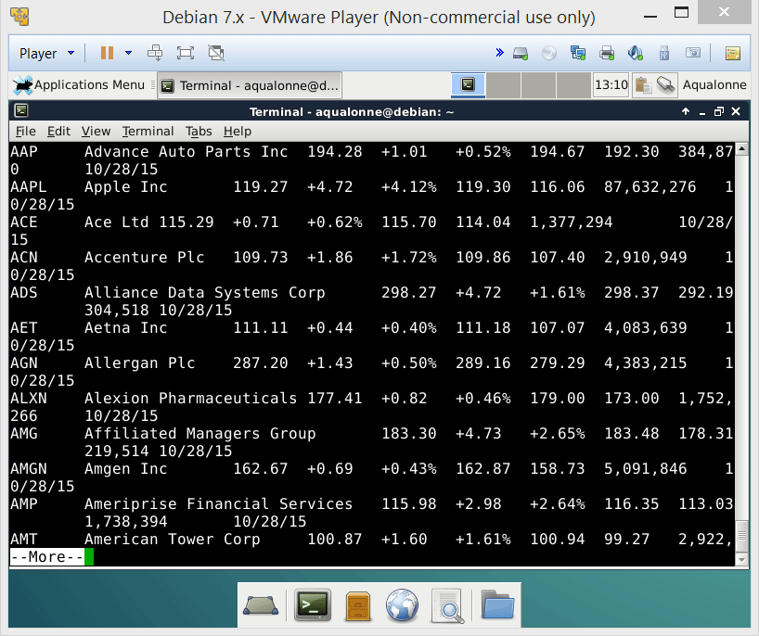
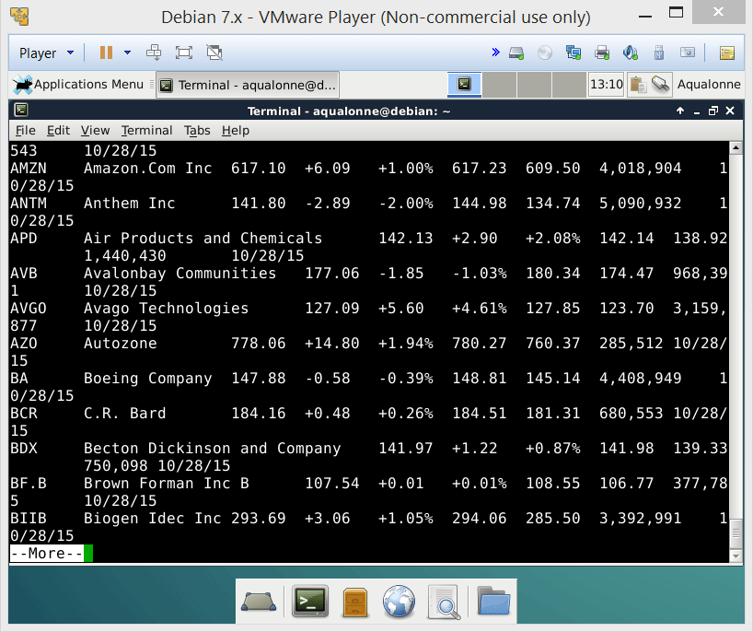
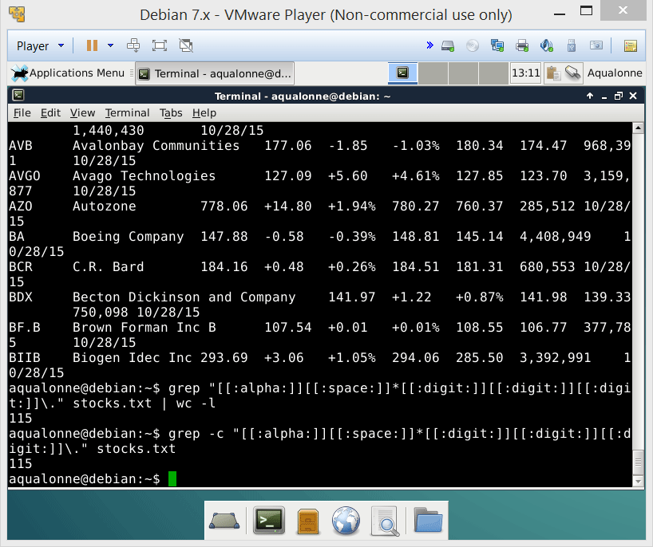

Finding lines by regex: Grep
You can ALSO use:
[] for alternative characters
[[:alnum:]] a-zA-Z0-9
[[:alpha:]] a-zA-Z
[[:lower:]] a-z
[[:upper:]] A-Z
[[:digit:]] 0-9
[[:space:]]
Grep options:
i Ignore case
w Match whole word
E For extended... adds
+
?
( )
How would you find all stocks that are worth hundreds of dollars? (i.e. from $100 to $999)
18
A crash intro to regular expression

Slide 19
Finding lines by regex: Grep
You can ALSO use:
[] for alternative characters
[[:alnum:]] a-zA-Z0-9
[[:alpha:]] a-zA-Z
[[:lower:]] a-z
[[:upper:]] A-Z
[[:digit:]] 0-9
[[:space:]]
Grep options:
i Ignore case
w Match whole word
E For extended... adds
+
?
( )
How would you list all stocks whose volume is at least 1M?
How can you list only those that don’t have numbers in their names?
19
A crash intro to regular expression

Slide 20
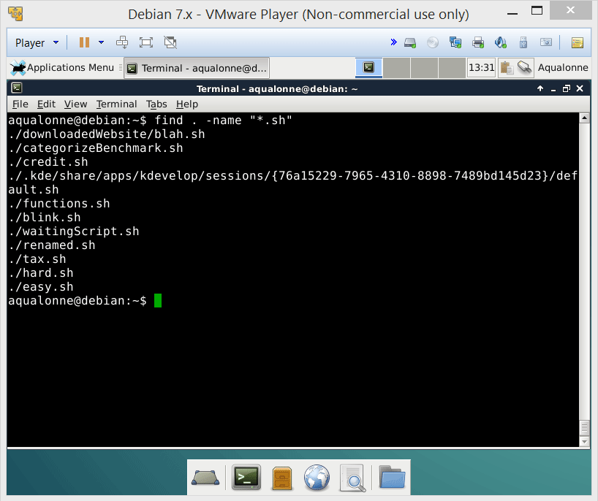

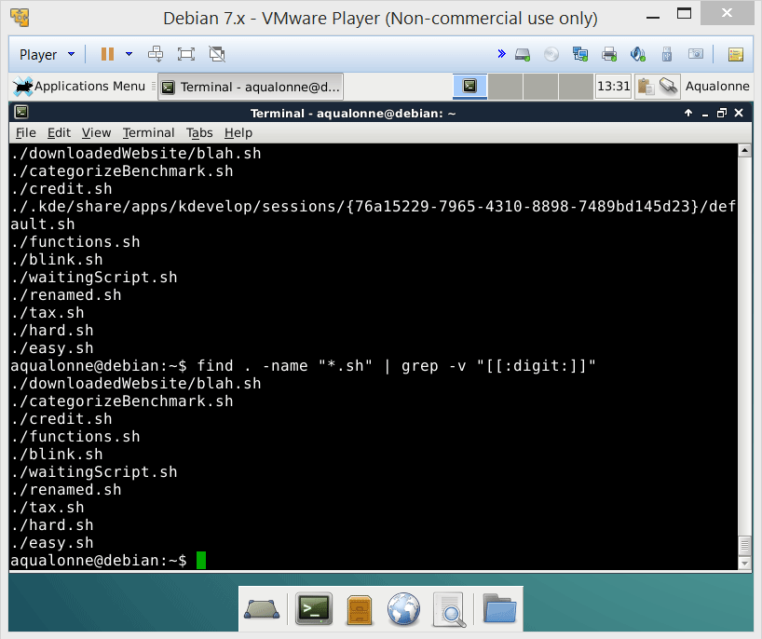
Finding lines by regex: Grep
You can ALSO use:
[] for alternative characters
[[:alnum:]] a-zA-Z0-9
[[:alpha:]] a-zA-Z
[[:lower:]] a-z
[[:upper:]] A-Z
[[:digit:]] 0-9
[[:space:]]
Grep options:
i Ignore case
w Match whole word
E For extended... adds
+
?
( )
How would you list all bash scripts in the current folder and subfolders?
How can you list only those that don’t have numbers in their names?
20
A crash intro to regular expression

Slide 21
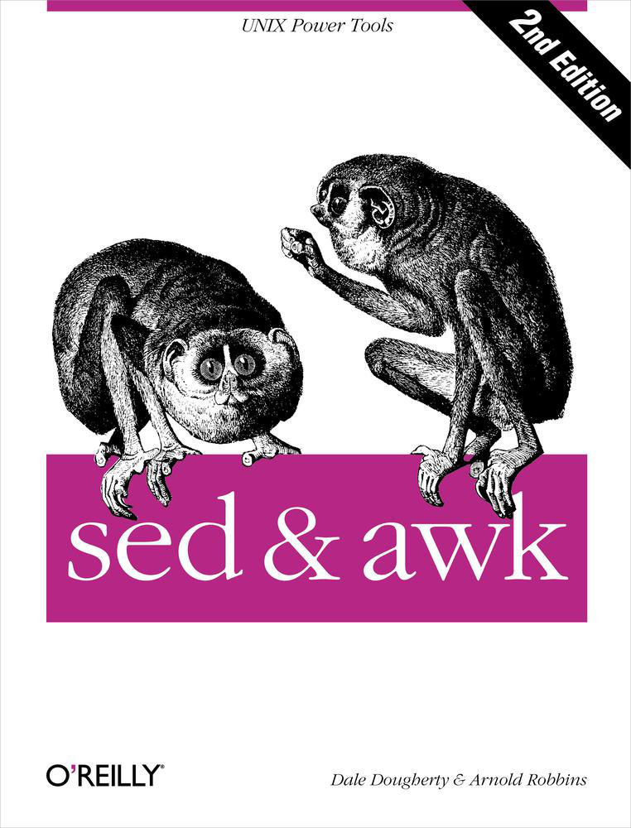
Language from Aho, Weinberger & Kernighan. Made in 1977 to manipulate streams of text.
Stream editors
Stream editor
Introduced in 1974
21
A crash intro to regular expression

